Slide 1

Web Development Foundations
02
HTML5 Essentials & Accessibility

Slide 2
Part 1: The Skeleton
Semantic HTML5 vs. The "Div-Soup"
Notes:
The Problem: Why <div> is a "meaningless" box and why it harms SEO and Screen Readers.
The Solution: The "Big Six" Semantic Tags (<header>, <nav>, <main>, <article>, <section>, <footer>).
Visual Structure: Mapping a modern website layout (like a blog or news site) to these tags.
Group Activity (10m): Open a popular website (like BBC or CNN) and have students "inspect" it to see if they can spot semantic tags in the wild.

Slide 3
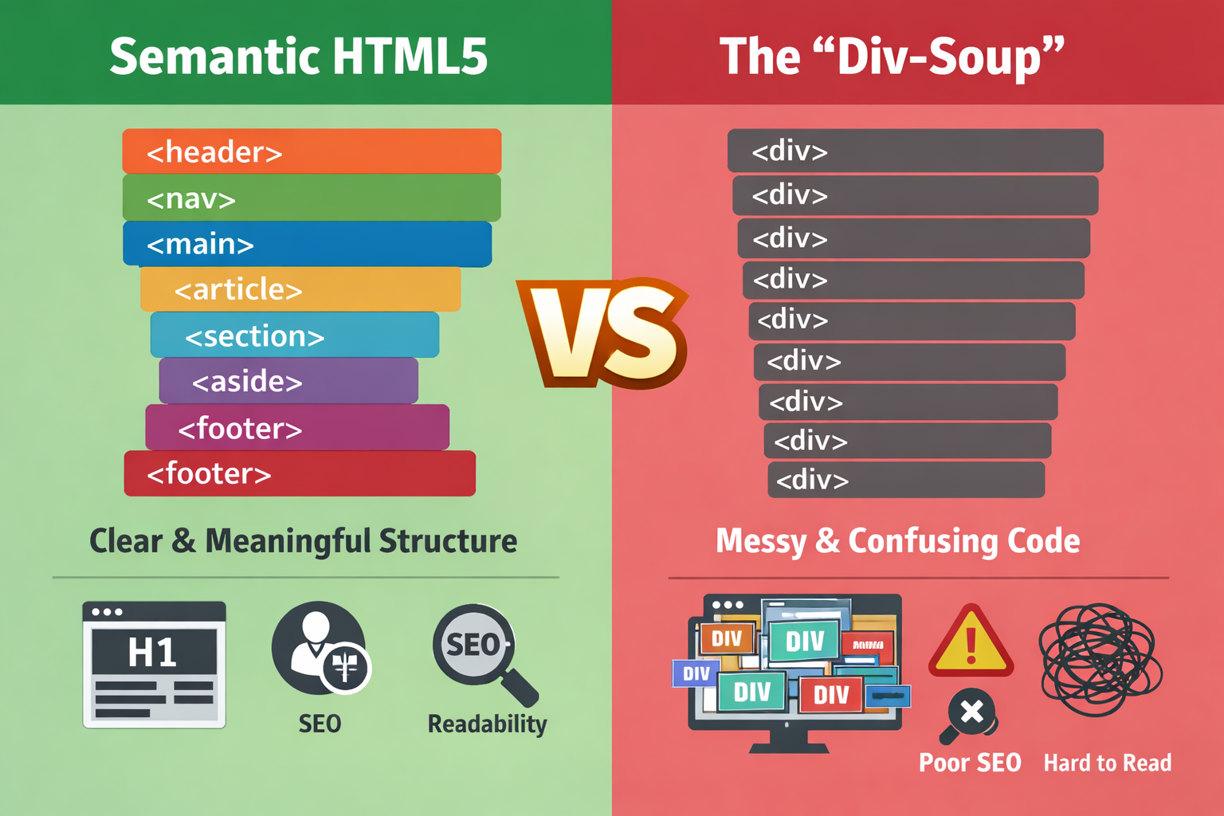
Source: ChatGPT

Slide 4
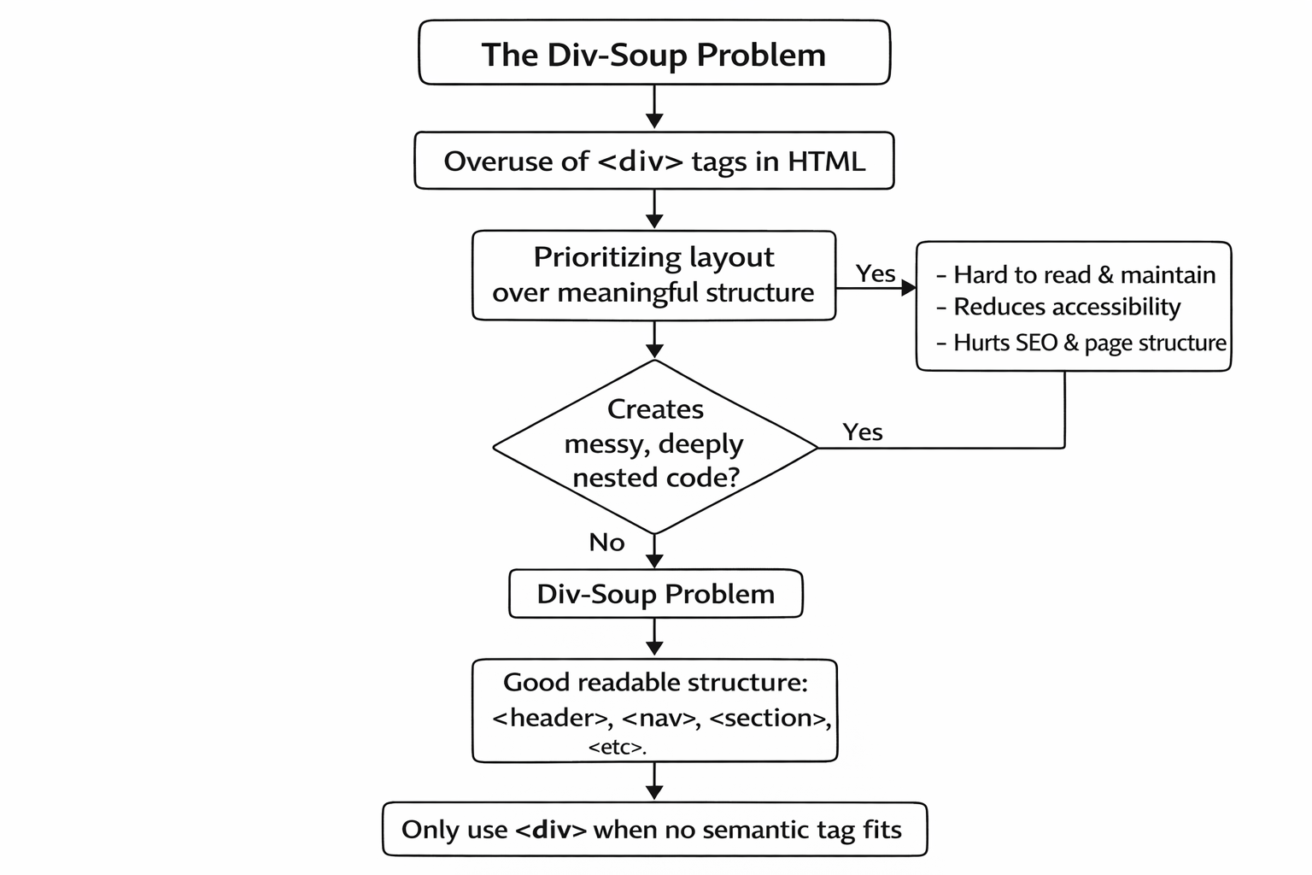
The Div-Soup
Div-soup is when too many <div> tags replace meaningful HTML structure, making code harder to understand and manage.

Slide 5
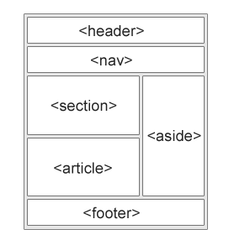
Semantic Elements in HTML
Many web sites contain HTML code like:
<div id="nav"> <div class="header"> <div id="footer"> to indicate navigation, header, and footer.
In HTML5 there are several semantic elements that can be used to define different parts of a web page:
More: https://www.w3schools.com/html/html5_semantic_elements.asp
Source: https://www.w3schools.com/html/html5_semantic_elements.asp

Slide 6
Group Activity
Notes:
Open a popular website (like BBC or CNN) and have students "inspect" it to see if they can spot semantic tags in the wild.

Slide 7
Part 2: The Interface
Accessible Forms & User Input

Slide 8
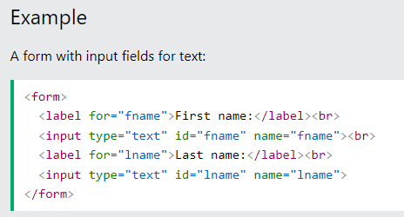
Form Structure & Labels
The <form> tag is a wrapper that collects data.
Attributes:
action: Where the data goes (the URL).
method: How it gets there (GET for searching, POST for sensitive data like passwords).
More Details: https://www.w3schools.com/html/html_forms.asp
Source: w3schoools.com

Slide 9
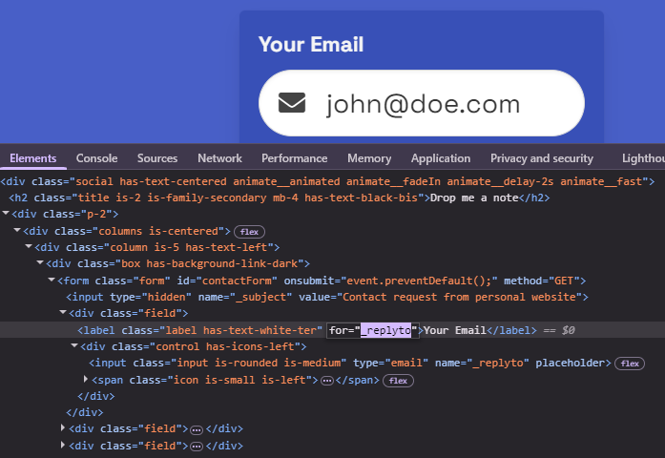
Form Controls and Labels
Form control is what we interact with, eg; input, textarea, button etc.
Every input must have a label
Screen readers won’t have any idea what an <input> is, its just a white box
Use the for attribute to link to the id attribute of the input
Source: midhunhk.com

Slide 10
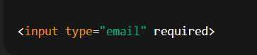
Input Types & Validation
Use correct input types
Helps users enter correct data
Use <textarea> for multi-line messages
Validation checks input automatically
The "Standard" Set:
email: Triggers the "@" key on mobile.
tel: Triggers the number pad.
number: Adds up/down arrows.
date: Opens a native calendar picker.
range: Creates a slider.

Slide 11
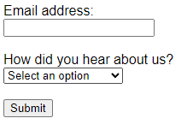
Forms Demo
Let’s Build a Sign-Up form

Slide 12
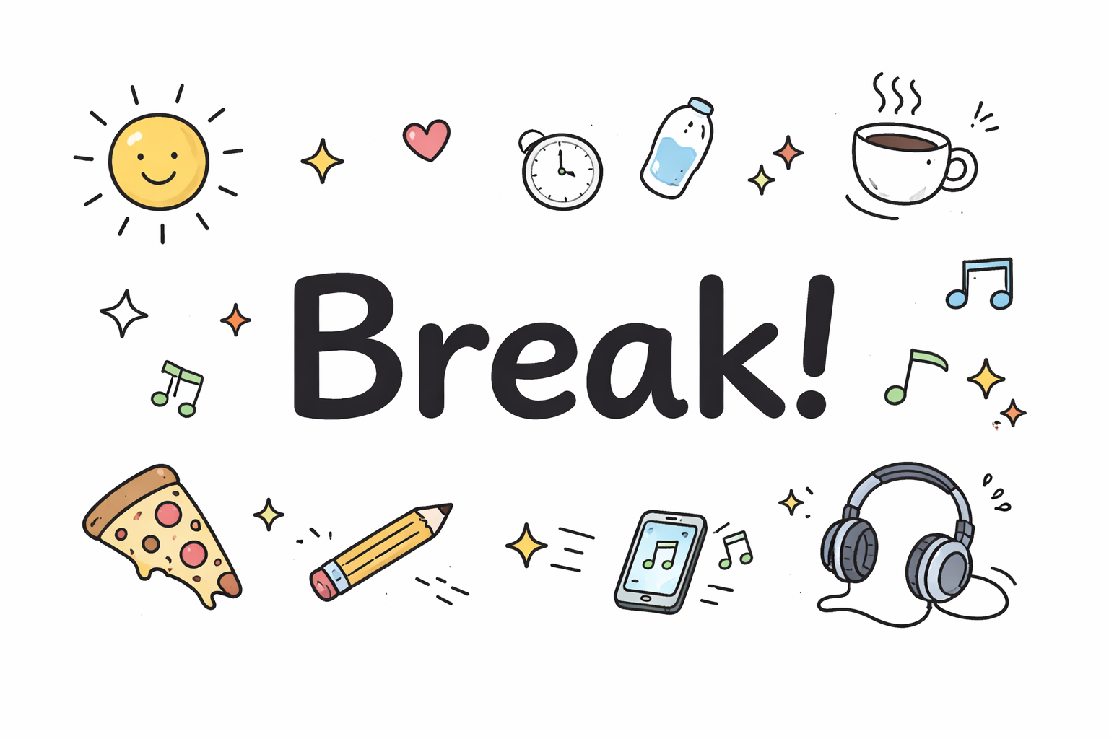
Notes:
https://timer-rosy-five.vercel.app/

Slide 13
Part 3: The Inclusive Web
Alt-Text, ARIA, and Accessibility Basics
Notes:
Part 3: The Inclusive Web (40 Minutes)
Topic: Alt-Text, ARIA, and Accessibility Basics
Images: Writing effective alt text (describing the intent, not just the pixels).
ARIA Basics: Introduction to aria-label and role attributes for when HTML tags aren't enough.
Contrast & Focus: A brief look at keyboard navigation (can you use your site with just the "Tab" key?).

Slide 14
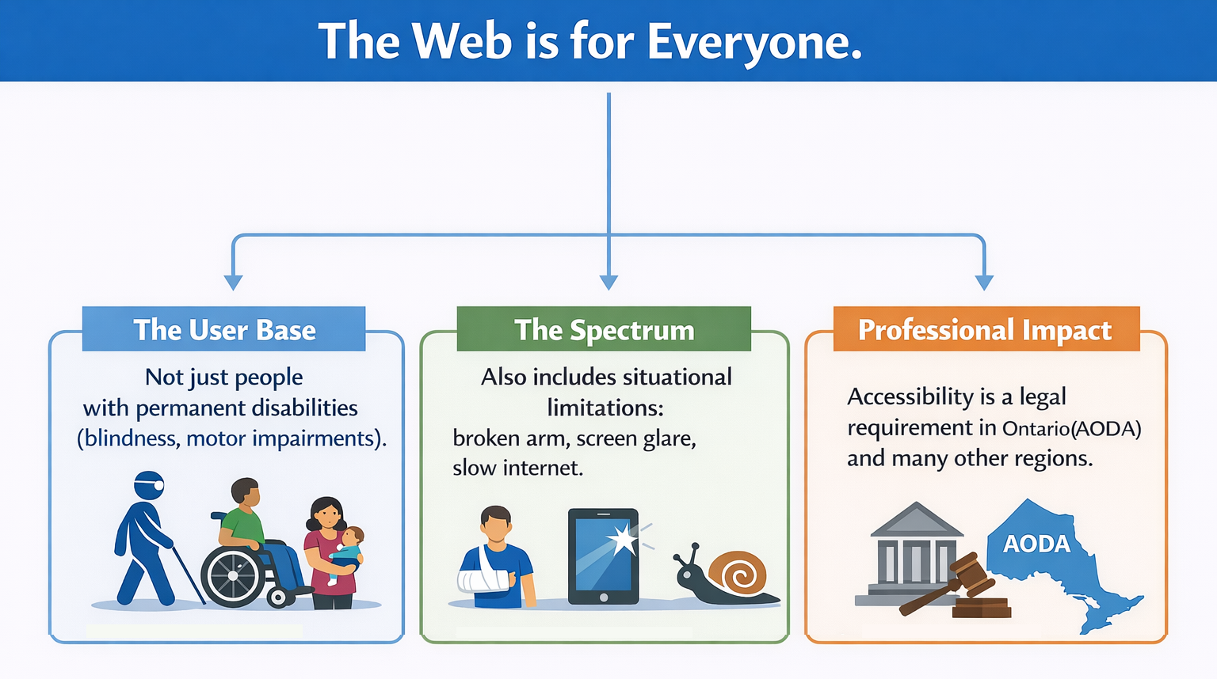
Source: ChatGPT
Source: ChatGPT

Slide 15
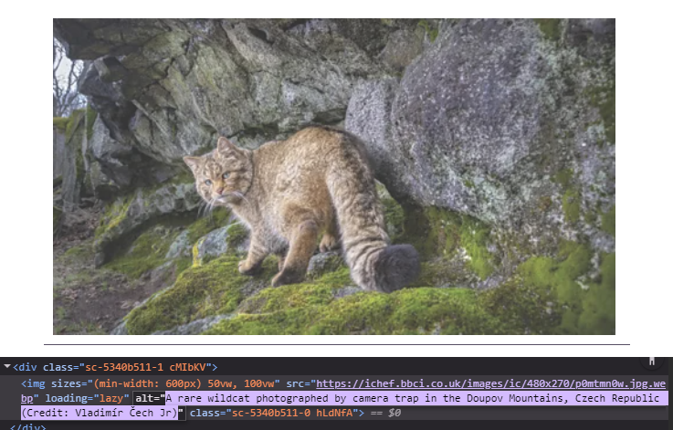
Beyond the Pixel
Screen readers read the alt attribute aloud. If missing, it may read the filename (e.g., "IMG_982.jpg").
The Three Rules of Alt-Text:
Be Descriptive: "Golden Retriever puppy" vs. "Dog."
Be Functional: If a button is an icon of a trash can, the alt text should be "Delete," not "Garbage bin."
Be Empty if Decorative: If the image is just a background flourish, use alt="" so screen readers skip it.
Image Source: bbc.com

Slide 16

Alt-Text Test
Which of the below alt-text is suitable for this image?
alt=””
alt=”image”
alt=”Vintage Red sports car parked on a street by the side of trees”
Discuss which is the best option and why?

Slide 17
When HTML isn’t Enough (ARIA)
ARIA - Accessible Rich Internet Applications.
ARIA supplements HTML so that interactions and widgets commonly used in applications can be passed to assistive technologies when there is not otherwise a mechanism.
The "Gold Standard": If a semantic HTML tag exists (like <nav> or <button>), use it.
The aria-label: Used when there is no visible text.
Example: A "Close" button that is just an "X" icon needs aria-label="Close".
The role attribute: Tells the browser what an element does if the tag doesn't say it.
Example: <div role="progressbar"></div>
Notes:
in the Professional Capacity section of their evaluation, following these standards is what separates a "student" from a "professional developer."

Slide 18
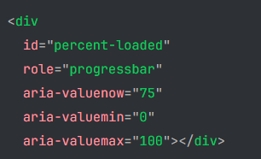
ARIA Example
Here's the markup for a progress bar widget:
This progress bar is built using a <div>, which has no meaning. We include ARIA roles and properties to add meaning.
In this example, the role="progressbar" attribute informs the browser that this element is actually a JavaScript-powered progress bar widget.

Slide 19
Exercise
Fix the broken code
<section>
<h3>Contact Me</h3>
<img src="my-photo.jpg"> <div>
Name: <input type="text"> </div>
<div style="background-color: #eee; color: #ddd;">
Submit </div>
</section>
Link: https://codepen.io/magnetik-works/pen/GgqrqOb
Notes:
The Solution they must commit:
Add alt="Headshot of [Student Name]".
Add a <label for="name"> and link it to the input id="name".
Change the <div> to a <button> and fix the color contrast.

Slide 20
Hands on Lab
Objective: Update your personal "landing page".
Update your file from Module 1 Lab to:
Refactor Structure: Wrap the "Hello World" content in <header> and <main> tags.
Add a Section: Create a "Contact me" section using <section>.
Build a Form: Inside that section, build a form with Name (text), Email (email), and a Message (textarea). Requirement: Every input must have a linked label.
Add Media: Insert an image with a descriptive alt attribute.
Commit & Push: Push the changes to GitHub.

Slide 21
Additional Activities
Complete the Lab if you have not been able to yet
Enhance the form by adding
minlength attribute to the message field
A custom placeholder message
Research
Research more advanced HTML5 validation used in forms
Practice
Take a screenshot of any website and draw boxes over it and label which semantic HTML5 tags should be used

Slide 22
Summary
3. The Inclusive Web
Alt-Text: Describe the function or intent, not just the pixels.
ARIA: Use it as a "safety net" when standard HTML tags aren't enough (e.g., aria-label for icon buttons).
The Tab Test: If you can’t navigate it with a keyboard, it’s not finished.
4. Professional Workflow
Clean Code: Indentation isn't just for looks; it prevents nesting errors.
Continuous Integration: Your code isn't "done" until it is committed and pushed to GitHub.
1. Structure with Purpose
Stop using <div> for everything. Use <header>, <nav>, <main>, and <footer> to give your page a "brain."
The Rule: If a tag exists that describes the content (like <article>), use it. It helps SEO and Screen Readers.
2. Interaction with Clarity
A <form> is nothing without a <label>. Always connect them using for and id.
Leverage HTML5 types (email, tel, date) to get free mobile optimization and validation.
Notes:
"Today we moved from making things 'visible' to making them 'meaningful.' A hobbyist builds a site that looks good on their own screen; a professional builds a site that works for a blind user, a keyboard-only user, and a search engine bot. When you go into your lab now, don't just ask 'Does this work?'—ask 'Is this accessible?'"

